Slide 1
Serendipity and Perseverance:
Injecting Testing in a Test-Resistant Team
Maaret Pyhäjärvi
Twitter: maaretp
Notes:
Agile teams are test-infected, but what to do when team releasing regularly is more test-resistant than infected? What if there is no unit testing, let alone test-driven development, and what if developers consider themselves too valuable to testing work? In this presentation, I’ll share my lessons learned with a test-resistant team acquiring a skilled tester to help with on-time feedback with hope of ability to focus on developing new features instead of going back to fix the once “done” features over and over again. Serendipity - happy accidents to find bugs without preconceived rational explanation - favors the ones who intentionally vary their actions, and developers too can test if only time allowed and taken for testing tasks that make sense.

Slide 2

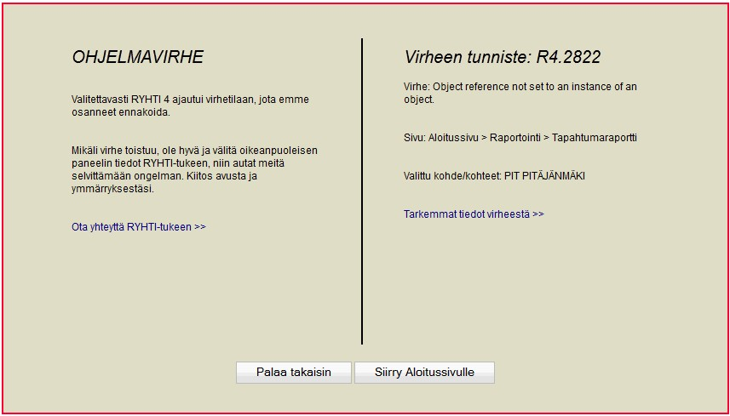
An Experience Report
Granlund Oy: 20 / 500 employees work with software
Forgiving customer base, bugs may increase sales
I joined 04/2012 as a testing specialist for two product teams
Change in scale may make a difference for quality issues too
Story of one of those teams, developing Granlund Manager (facilities management)
Decades of successful software development without specialized testers
2011.5 13 %
2012.9 1.6 %
2013.6 1 .0 %

Slide 3
Learning About My Team
T
Customers
C
T
T
C
T
PdM
T
T
T
C
A
PdM
T
PdM
C
PdM
Development
ASP.NET application with 155269 lines of code and 130152 lines of comments
PdM
Product & Support
Users
C
Management
PdM
PjM

Slide 4
How We See Development and Testing
SELECTED ON RISK
Production
Development & Own testing
System Testing
Acceptance Testing & Acceptance code review
MOST ISSUES
Developing and verifying that development matches what was supposed to be delivered, no side effects
Specialists in close collaboration with the developers
Testing while it’s not finished.
Sample testing that should not find bugs
Accept with known issues from other testing
Notes:
We have three names for testing the product as a whole
”Own testing” when developers do it for their own changes
”System testing” when testers in the team take parts of developer testing responsibility and add risk-based testing developer deems unnecessary
”Acceptance testing” when product management does the same thing, focusing on what was written on Jira issue to accept + own guesses

Slide 5
Monthly releases
VARIED ATTITUDES
No unit testing
”I’m too valuable to test”
No test automation
”I try but won’t find the bugs anyway”
Some testing by (frustrated) product managers
”We know it does not work, and fix whenever we learn how to reproduce”
”Breaks often”
”Customers don’t complain”
Fix deployed in an hour
after customer contact
Notes:
Far from test infected. Lessons learned on bugs being as much work for devs whether found internally or externally.

Slide 6
Approaches to Change
Unit test training
First Tester
Stealth pairing
1.8 %
6.6%
Remote tester
Unit tests
UI tests
DoD
NOW
ET
Most important for business
Fix / Refactor
CI with tests
Complete area rewrites
Test-Fix-Finalize week
New features
=> Remove test cases (e.g. 39 pages with 3 bits of info → 2 page checklist of 59 items)
Notes:
ET first: adding visibility to bugs that were there already
Fixing the mess that causes so many of the problems
Loops within loops, no reuse in code
Unnecessary complexity, more LOC to maintain
Attitude / skill issues made us miss unit tests on these…

Slide 7
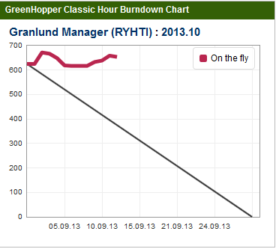
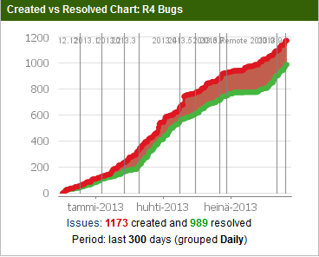
The Current Challenges
Notes:
Plan the increment contents that we could actually deliver -> show picture of burndowns
Put development and testing together
Assuming always there are no more bugs to find, despite conflicting evidence
See that it may take ½ a day to find a bug that takes an hour to fix
Not belittle the fixing time – surprising how two 10 minute fixes happen in a day
Makes it very hard to decide what might get help in testing by the team testers

Slide 8
Serendipity and Perseverance
Serendipity = Lucky accident
Just my luck?
  Luck favors the ones who intentionally vary their actions
”The more I practice, the luckier I get”
Perseverance = Keep trying
Testing takes time – keep trying with more ideas, stop giving up so easily
“It's not that I'm so smart, it's just that I stay with problems longer.”
Notes:
Yesterday arriving at the hotel, they gave me a room number and a key – those just did not match
First day at new work I created a bookmark to remember the system. First use => program error
Started testing a new feature and needed a user account for that. Decided to take an old one and change its password => program error
It's not that I'm so smart, it's just that I stay with problems longer. – Albert Einstein
The more I practice, the luckier I get – Arnold Palmer

